Slide 1

Capstone project
Heart Condition Classification

Slide 2
Project Steps
Problem
Identify the problem and the business plan
Plan
Describe the process
Application
Apply the solution
Solution
Conclude if the solution satisfies the company’s needs

Slide 3
The Business Problem
An insurance company needs to develop a model that will save time and money
We want to focus on identify potential heart conditions of the company’s clients
Fast way to classify clients as healthy or prone to heart disease
Refer the clients that are classified as potentially conditioned to a doctor for further examination

Slide 4
The Plan
We will use modern Data Science tools to achieve that
Gather data from existing patients
Use classification machine learning algorithm
Test the accuracy of the model
Apply an accurate model to the company’s clients

Slide 5
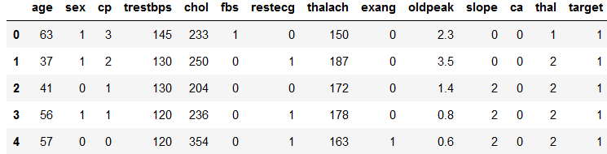
The Data
The original dataset is based on real patients' cases
Uses features recommended by doctors as important indicators
The records are already classified as healthy or not in order to train and test the model
The records are numerous so that the model is accurate enough

Slide 6

The Algorithm
We will be using the Support Vector Machine (SVM) algorithm
Splitting the dataset to random train and test sets
Using the train set to find the dependencies of the features on the class
Using the test set to evaluate the accuracy

Slide 7
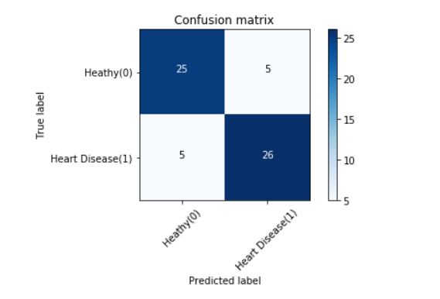
The Results
Confusion Matrix
F1 score and Jaccard Similarity reveal 83% accuracy
Satisfying results lead to usage of the model

